Slide 1

WEB INTERFACED ATTANDANCE CONNECTED
GOOGLE SHEET
Institut Teknologi Del Jl. Sisingamangaraja Sitoluama, Laguboti 22381
Toba – SUMUT http://www.del.ac.id
FIRST YEAR PROJECTS
INSTITUT TEKNOLOGI DEL

Slide 2
Prepared By
GROUP 13 – DIII NETWORK MANAGEMENT
NIM | NAME
13320023 | Paul Nainggolan
13320007 | Josua Panggabean
13320019 | Samuel Sianipar
Guided by
Pandopatan Siagian, ST, M.Eng
Tested by
Marojahan MT. Sigiro, ST., M.Sc
Ahmad Zatnika Purwalaksana, S.Si., M.Si.

Slide 3
Agenda
01
Introduction
02
General Description
03
System Overview
04
Detail Design
05
Conclusion
05
Detail Design

Slide 4
INTRODUCTION
Topic : The web interfaced attendance connected to Google Sheet
Background :
To complete First Year Project
To develop our skill and creativity in designing and developing website using PHP and database .
Objectives :
To help administration in processing students attendance
To make it easier for teachers to do students attendance
To diminishes paper use which preserve 100% accuracy
To make it easier for recap attendance data

Slide 5






General Description of
Application Delovep
The web interfaced attendance connected to Google Sheet is an application built using PHP with HTML, Bootstrap,Javascript, CSS, REST API and JSON.
The main functions:
1 | Login | 6 | Managing Study Schedule
2 | Managing Account Data | 7 | View Student Data
3 | Managing Teacher Data | 8 | Attendance Filling Function
4 | Managing Student Data | 9 | Sending Attendance Data Report
5 | Generating Absent Function | 10 | Managing User/Admin Profile

Slide 6
SYSTEM
OVERVIEW
01
02
Current System
Target System
Teachers still use manual methods to:
Manage attendance for each class
Send attendance book
The class leader still uses the manual method to:
Do attendance on paper
Check every student present
Return the attendance book
Easier for Administration staff and teachers.
Shorten the time to do attendance.
Administration can manage data more easily Students are no longer absent but will be done by the teacher.
And can view and share the results of the recap via the google sheet link.

Slide 7
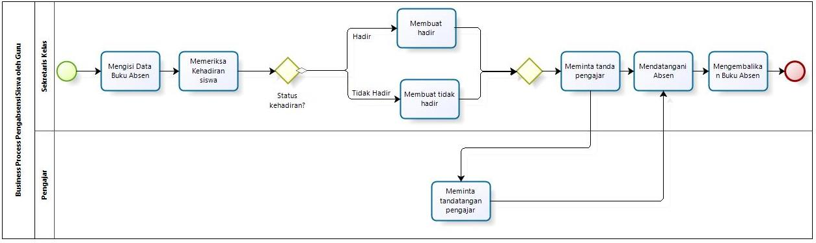
BUSINESS PROCESS
ATTANDANCE
Current
System

Slide 8
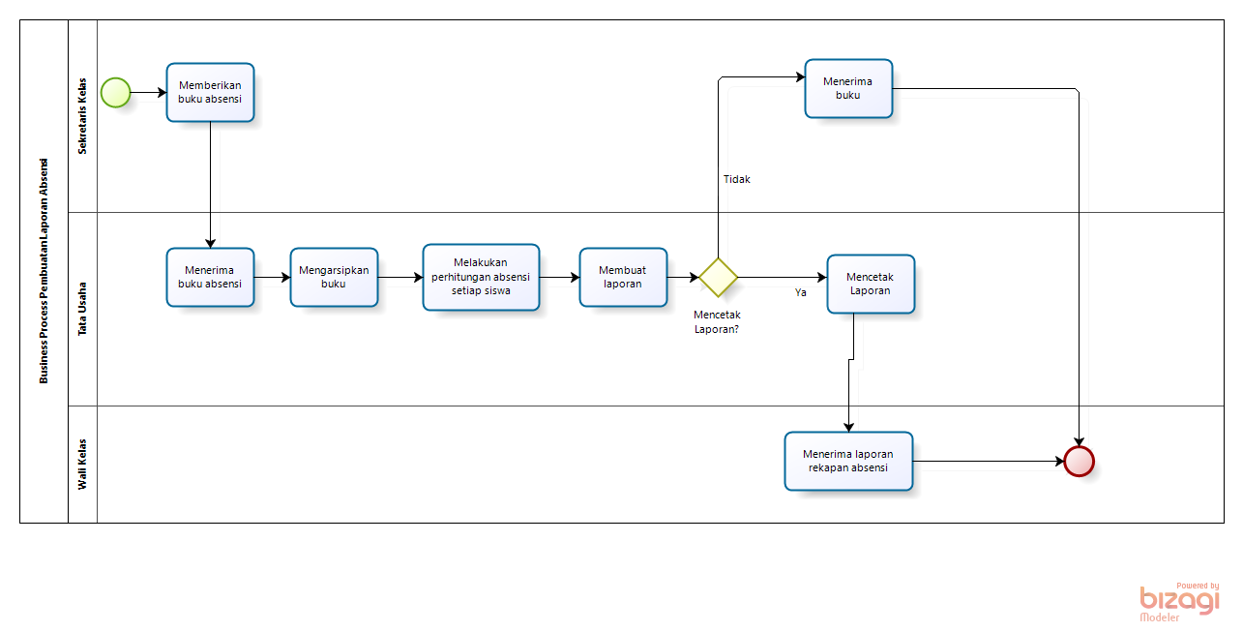
BUSINESS PROCESS
ATTANDANCE REPORTING
Current
System

Slide 9
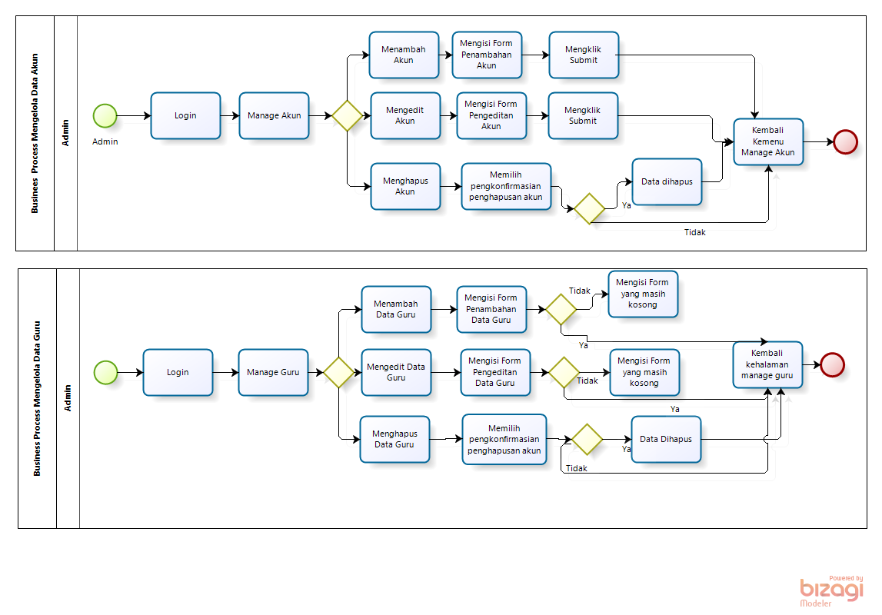
BUSINESS PROCESS
Manage Account Data
Target System

Slide 10
BUSINESS PROCESS
Manage Teacher Data
Target System

Slide 11
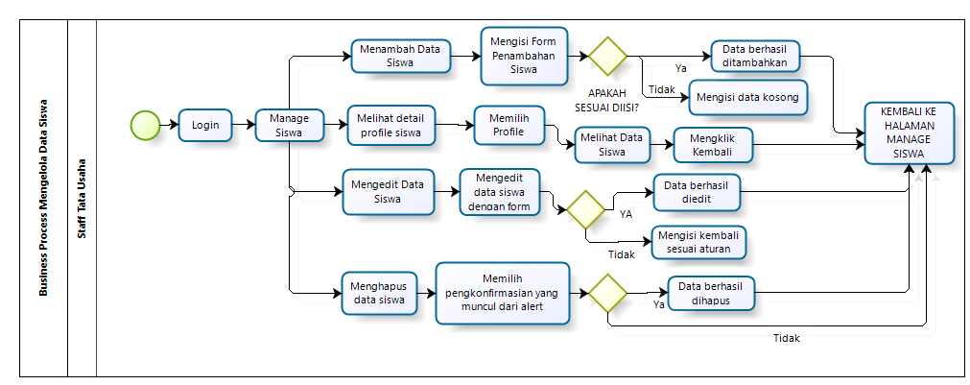
BUSINESS PROCESS
Manage Student Data
Target System

Slide 12
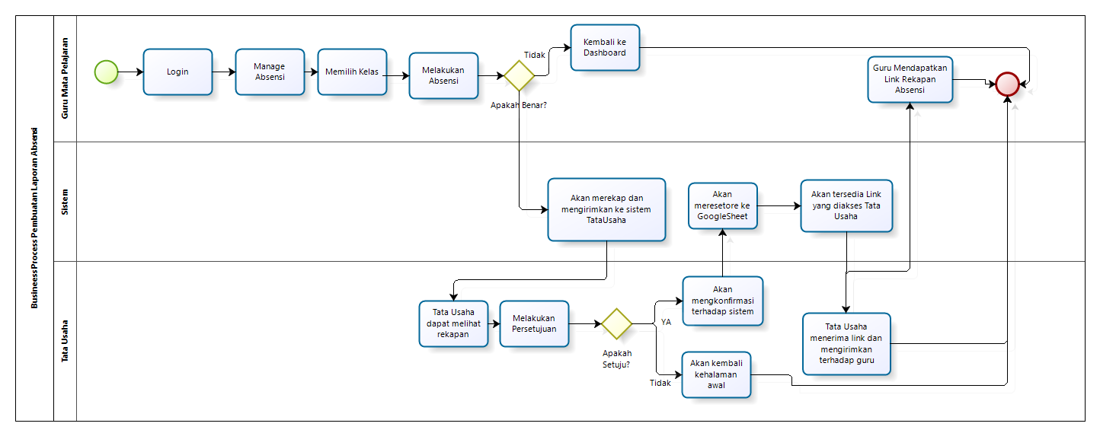
BUSINESS PROCESS
Generate Absent
Target System

Slide 13
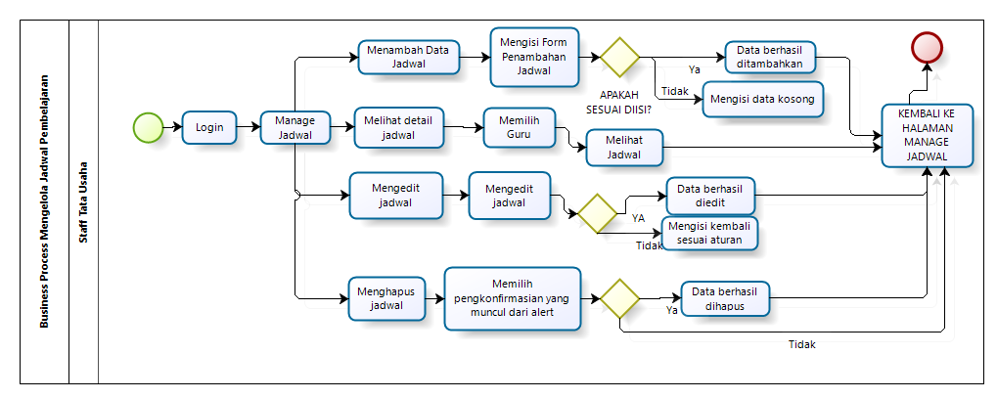
BUSINESS PROCESS
MANAGING STUDENT
SCHEDULE
Target System

Slide 14
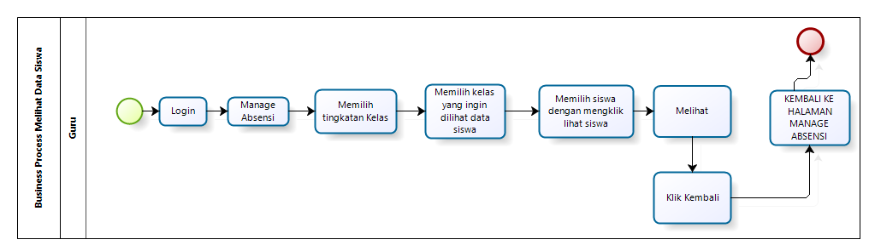
BUSINESS PROCESS
VIEW STUDENT DATA
Target System

Slide 15
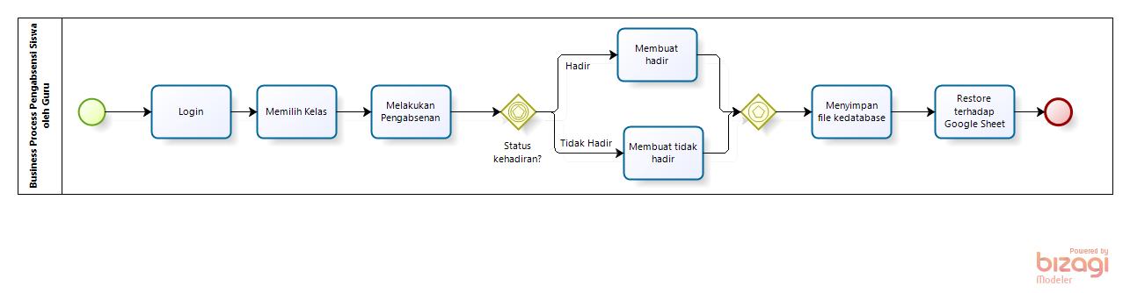
BUSINESS PROCESS
ATTANDACE FILLING
Target System

Slide 16
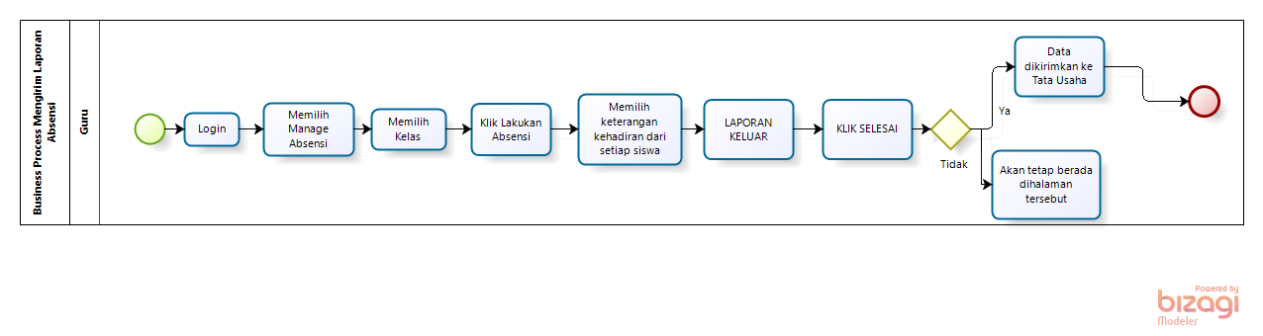
BUSINESS PROCESS
SENDING ATTANDANCE
Target System

Slide 17
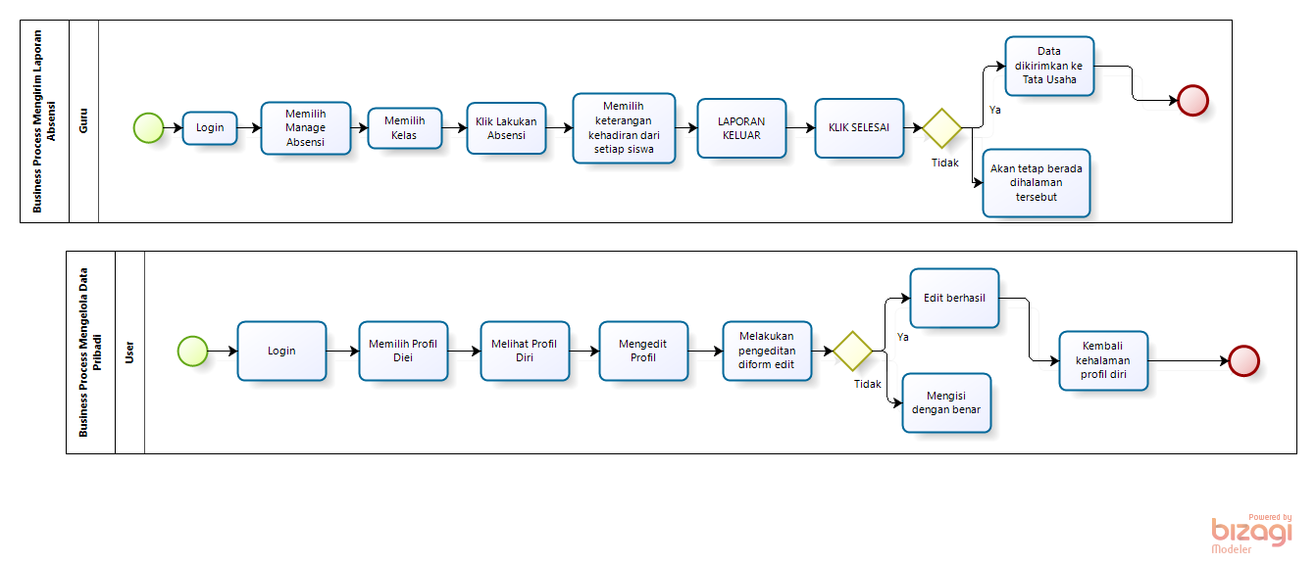
BUSINESS PROCESS
MANAGE USER/ADMIN
PROFILE
Target System

Slide 18
HOW CONNECTED TO
GOOGLE SHEET?
REST API
Create the latest gsheet file with columns
Access using console developers
Create a new project
Choose apis and services
Enter google sheet search
Select enable
Select create credentials
Select google sheets api and then select web server and for application data
Write the name of the service account and select the role "owner"

Slide 19
HOW CONNECTED TO
GOOGLE SHEET?
REST API
10. Downloading the json file
11. Edit the previously downloaded json file
And what the client-email copy does to the shared file google sheet.
12. See the documentation on the google sheet on the delevopers google sheet on the quickstart php
13. Then asked to install composer google api client
14. Copy the script $require, $client, $service , $spreesheetID from developers.google.com/sheet/quickstart/php
15. RUN FILE CRUD.php
16. Create an insert function script for google sheet which is connected to crud.php

Slide 20
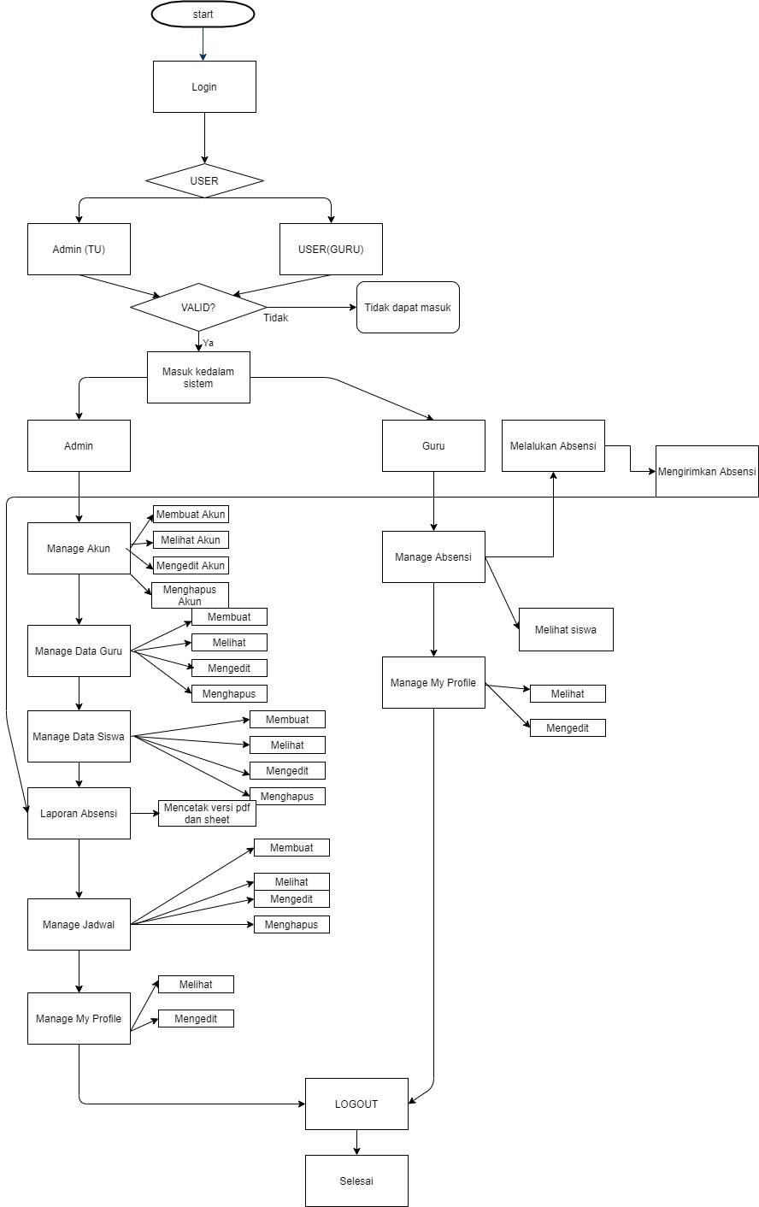
DETAIL DESIGN

Slide 21
CONCLUSION
We have finished developing the website based on the specified requirements
The new system has increased the service time compared to the previous system
Web Interface Attendance connected to google sheet is a dynamic website-based system that can be used by teachers and administrative staff to take attendance in schools

Slide 22
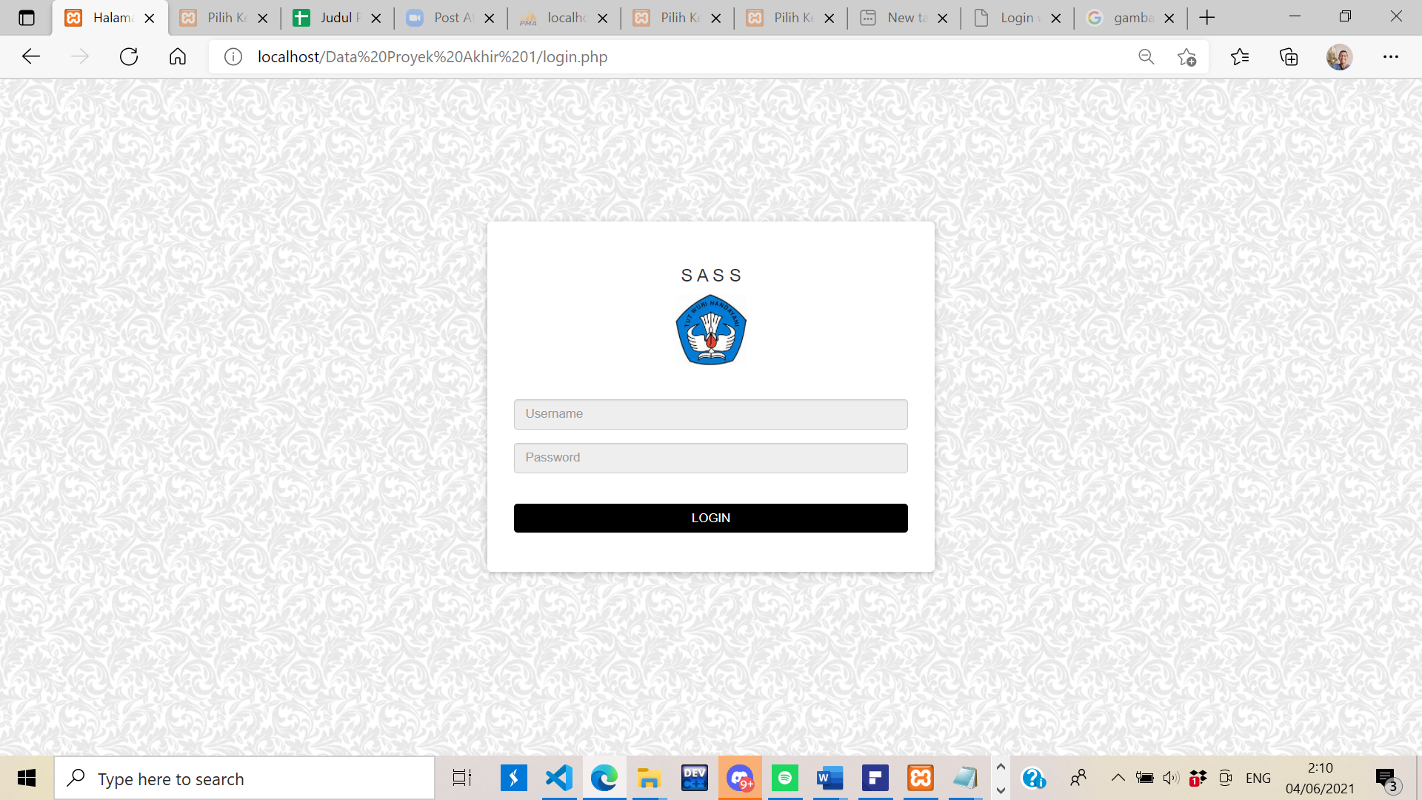
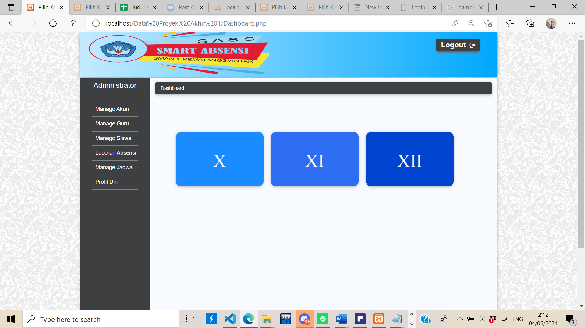
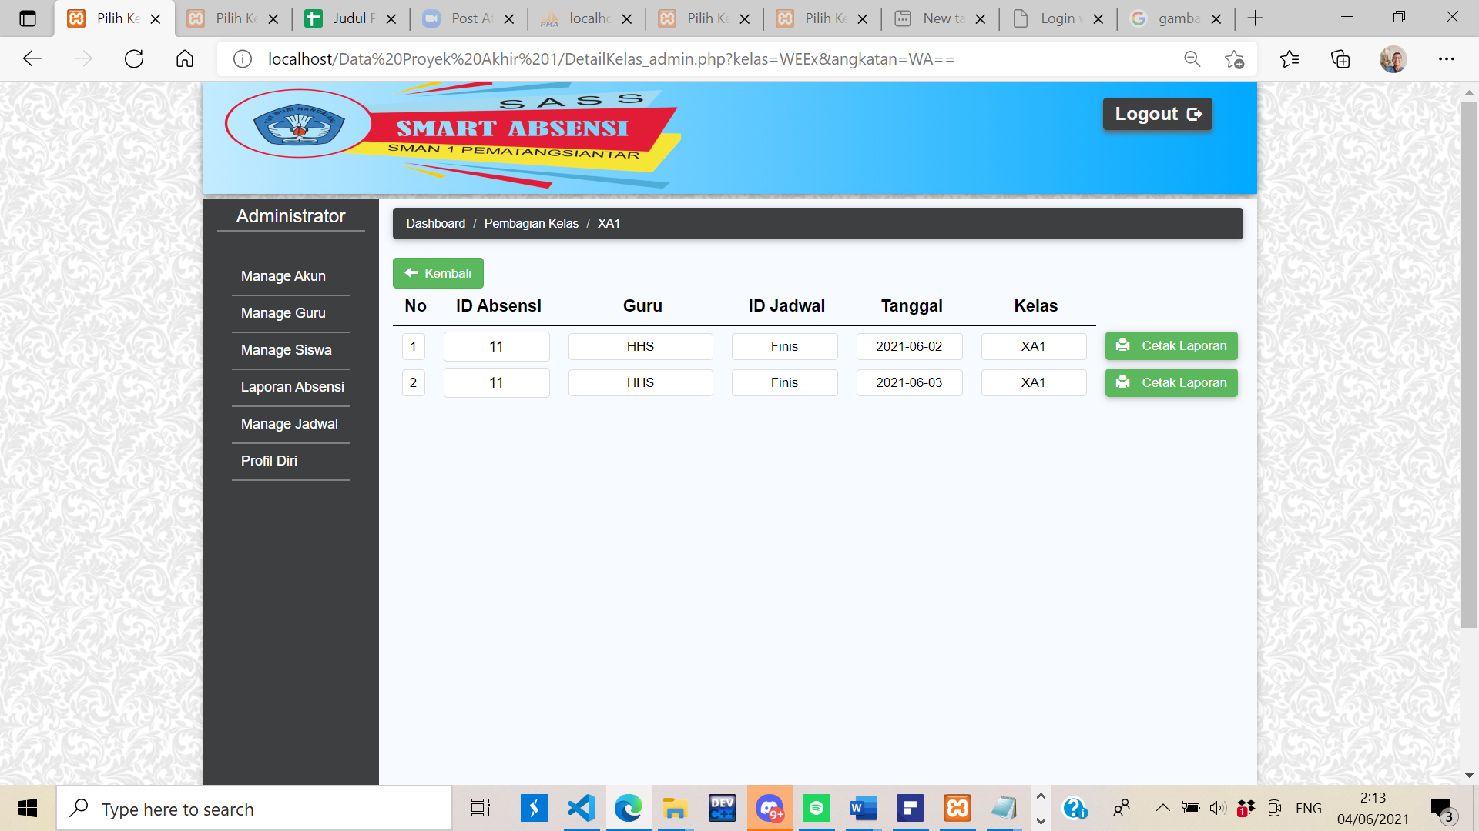

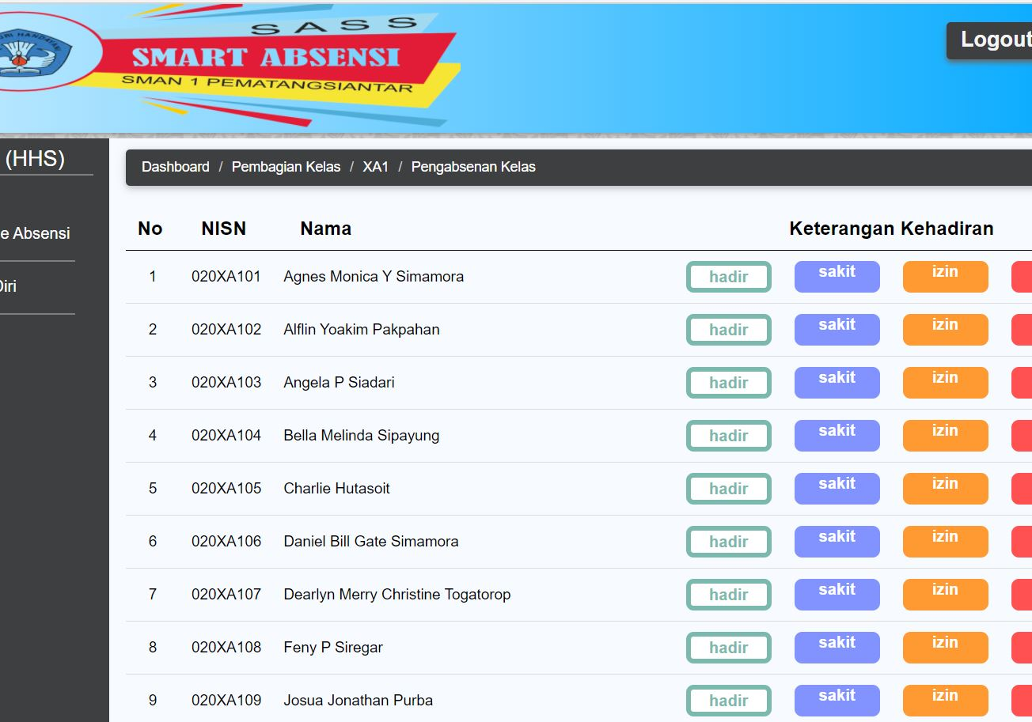
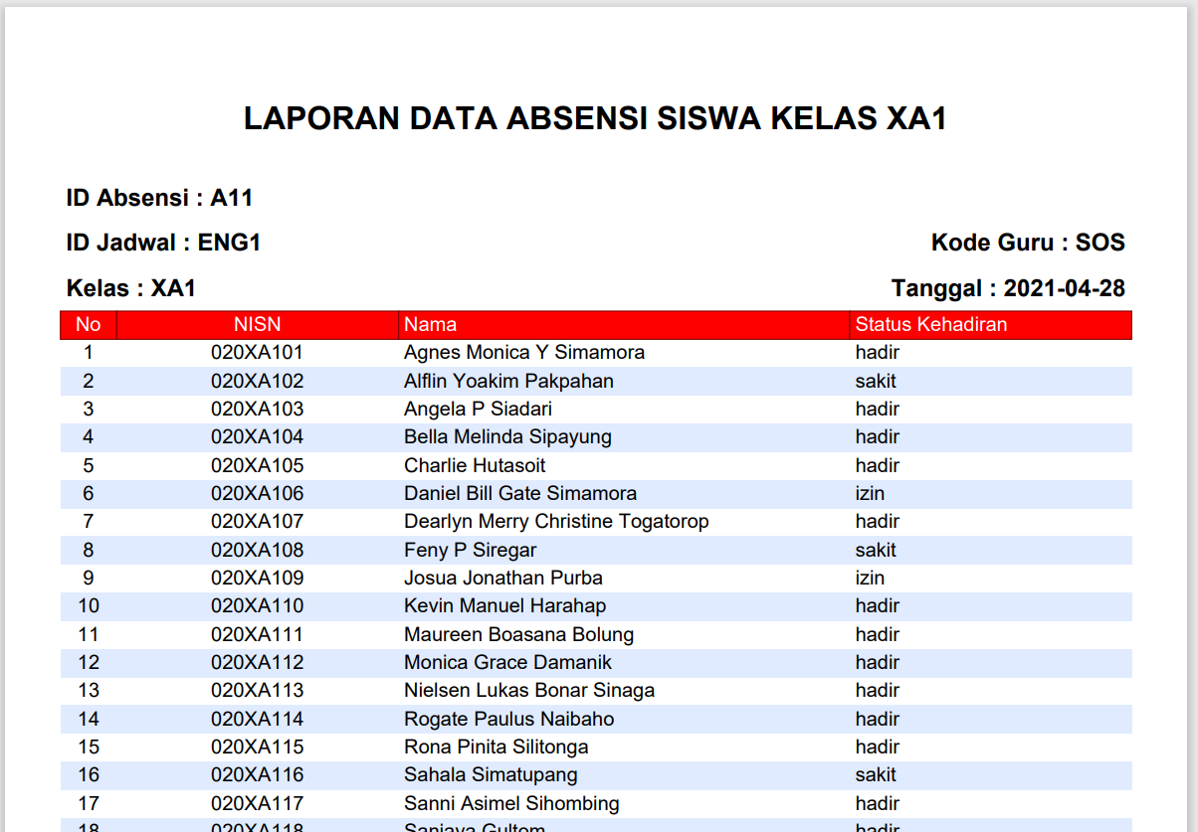
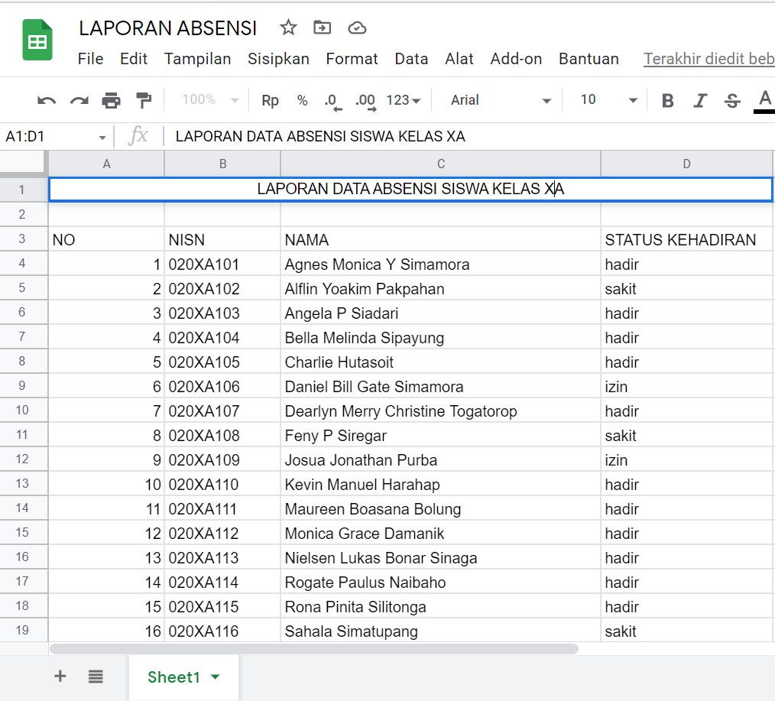
WEB INTERFACE
ATTANDANCE
CONNECTED TO
GOOGLE SHEET

Slide 23
DEMO
PROJECT
WEB INTERFACE ATTANDANCE CONNECTED TO
GOOGLE SHEET

Slide 24
THANK YOU
“WEB INTERFACE ATTANDANCE CONNECTED TO GOOGLE SHEET”

